Slide 1
GIMMICK GAMES
An Analysis and Design Presentation
Abdulmohaimin Bashir
Muhammad Bilal
Mohammed Islam Haji
Nusaibah Mekkaoui

Slide 2
Table of contents
01
02
03
04
Overview
System Analysis
System Design
Database Design

Slide 3
01
Overview

Slide 4

Overview
Gimmick Games is an online mini game platform highlighting
Authentication, Sign up & Forgot Password features
Player Profile, Leaderboards, and Score storage and management in a database
Two Retro Games entertaining both casual and veteran players
Gimmick Games aims to keep its platform dynamic and user-friendly with its easy to navigate and appealing user-interface, all while keeping data in the database easy to manipulate and manage.

Slide 5
02
System Analysis

Slide 6
Functional & Nonfunctional Requirments
Functional Requirments
Non-functional Requirements
Login page: User can login with an email and password and assign a username to their profile
Security: using passport authorization to control access to certain features & fending off XSS.
Main page: Users can select and play any game from the home page.
Efficiency: in terms of both database access and management as well as in game interactions
Game page: Guests and registered users alike can play the games and view leaderboards in their profile; however, only registered users can save their scores
Maintainablity: organized codebase with separation of components facilitates maintenance and modification.

Slide 7
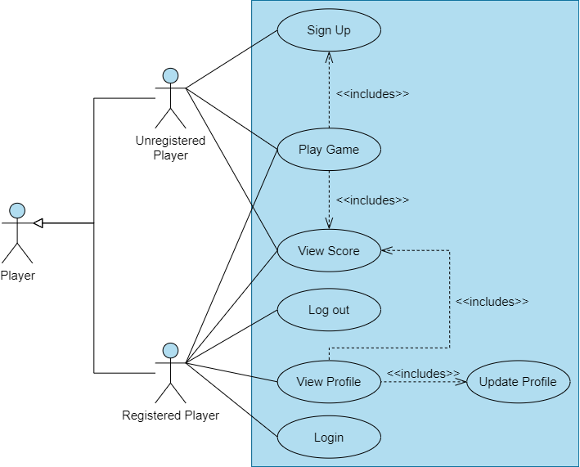
Use Case Diagram

Slide 8
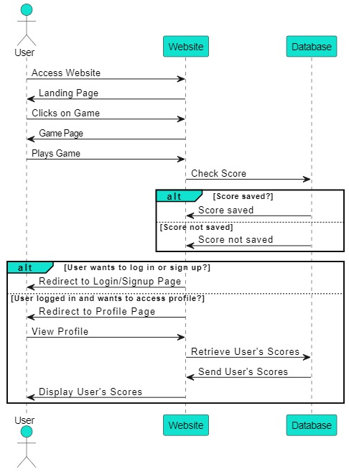
Sequence Diagram

Slide 9
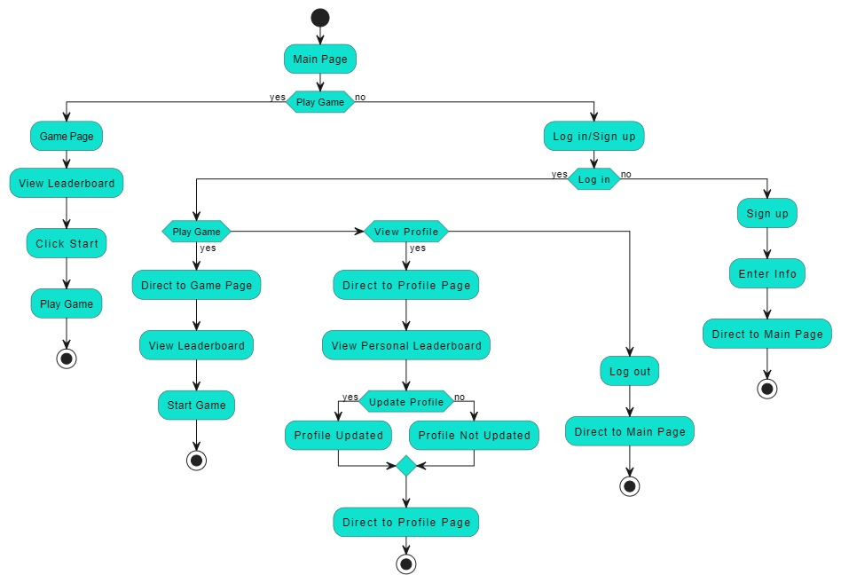
Activity Diagram

Slide 10
03
System Design

Slide 11
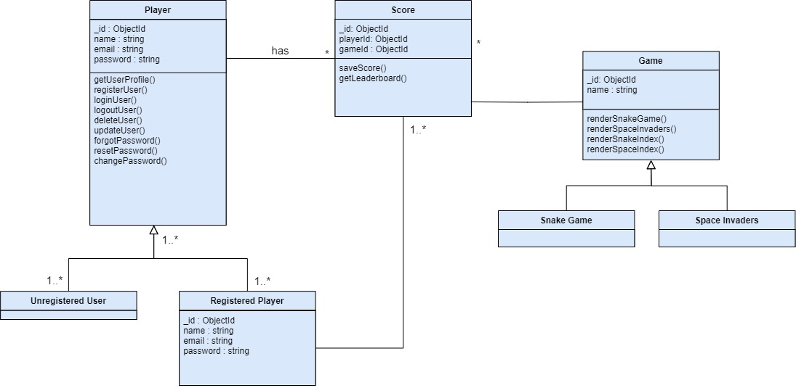
Class Diagram

Slide 12
Design Pattern
Model-View-Controller (MVC)
Model: includes the data for players, scores, and games
View: the interface made by combining DHTML(Dynamic HTML),
Bootstrap, and EJS.
Controller: manages the interactions with the database and the view

Slide 13
04
Database Design

Slide 14
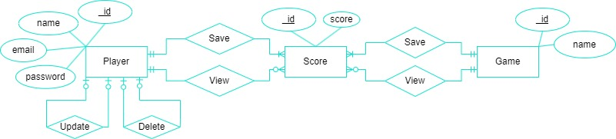
ER Diagrams

Slide 15
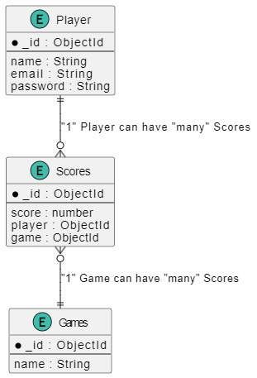
ER Diagrams
Gimmick Games thought it best to go with a database-first approach when design and implementing our database.

Slide 16
Technologies To Be Used
Runtime Environment
Database
MongoDB is highly scalable and allows for storage of data as JSON-documents. Modelling method will be ODM. Our ODM of choice is Mongoose.
Node.js is used for server side JS execution due to its ability to handle multiple requests asynchronously.
Frameworks
API Testing
Postman used for API testing
Express used for conducting backend data management.
Bootstrap used for frontend development.

Slide 17
Thank you
Do you have any questions?
“We spiraled downward as a society when we ended the age of retro games and vintage consoles. It is my firm belief that we should bring them back.” – Nusaibah Mekkaoui

